Slide 1
Arrays
Arrays
Syntax
Length and Index
Multi-Dimensional
Storage
Initializing
Notes:
Time: 5

Slide 2
Arrays
Arrays
Collection of Similar Items in Sequence
Contains values or references
Fixed, Finite Length
Notes:
Time: 20

Slide 3
Syntax
Declaration
Type
Name
Dimensions
Creation
Length
Initialization
Notes:
Time: 20

Slide 4
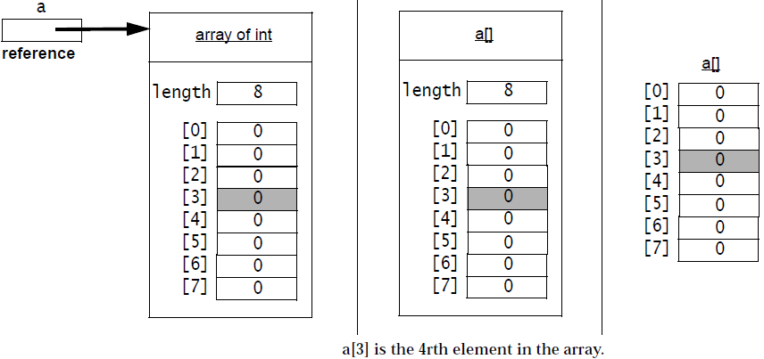
Length and Index
Do not get confused
Notes:
Time: 10
Image from Slide 8 of “5 Arrays.pdf”

Slide 5
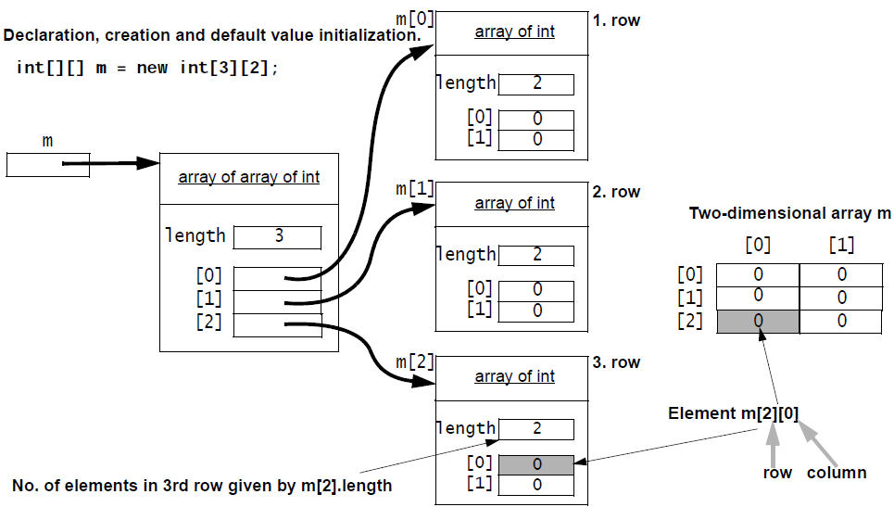
Multi-Dimensional Arrays
Array of Arrays
Notes:
Time: 5
- Image from Slide 9 of “5 Arrays.pdf”

Slide 6
Multi-Dimensional Arrays
2D Arrays
3D and More
Enhanced “For” Loop
Iterate through each Value
No Counter
Fetches the Length Once
Notes:
Estimated Time: 1h 30m
- The Java language does not limit the number of dimensions, but the Java VM spec limits the number of dimensions to 255

